Slide 1
Step 7

Slide 2
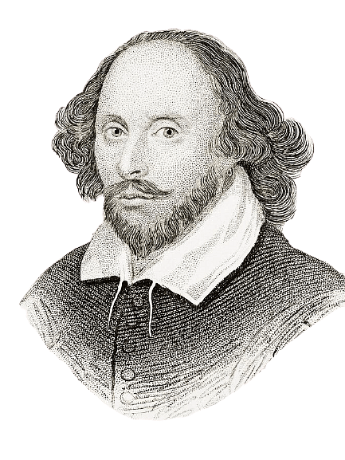
What do you remember about William Shakespeare?
English dramatist
Education
Date of birth
writer
Plays and sonnets
Family
Career
Famous phrases
Hometown
1616, 23–rd April

Slide 3
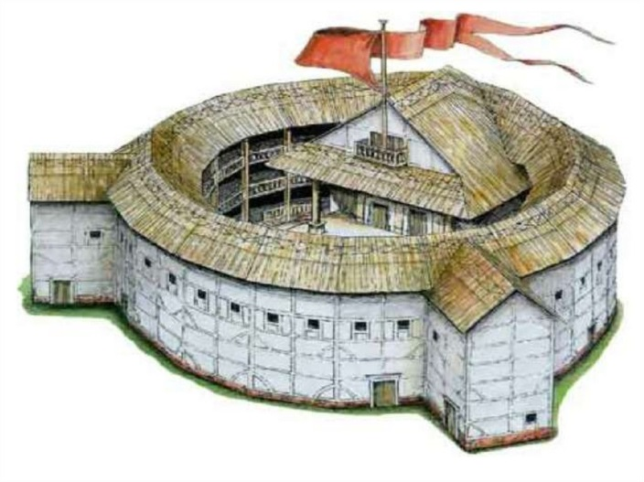
What do you remember about The Globe Theatre
1598
1613
Perform in the afternoon

Slide 4
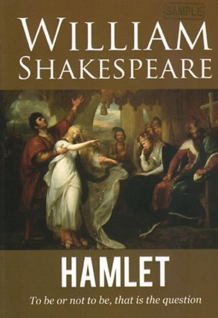
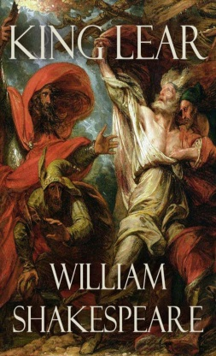
William Shakespeare’s plays

Slide 5
Слово | Транскрипция | Перевод
alike | [əlaɪk] | похожий
be / look alike |  | быть похожим
allow | [əlaʊ] | разрешать
fair | [feə] | справедливый, светлый
hold (held) | [həʊld] | держать
refuse | [rɪfjuːz] | отказывать(ся)
reply (to) | [rɪplaɪ] | отвечать
safe | [seɪf] | безопасный
safe and sound |  | целый и невредимый
willingly | [wɪlɪŋli] | охотно

Slide 6
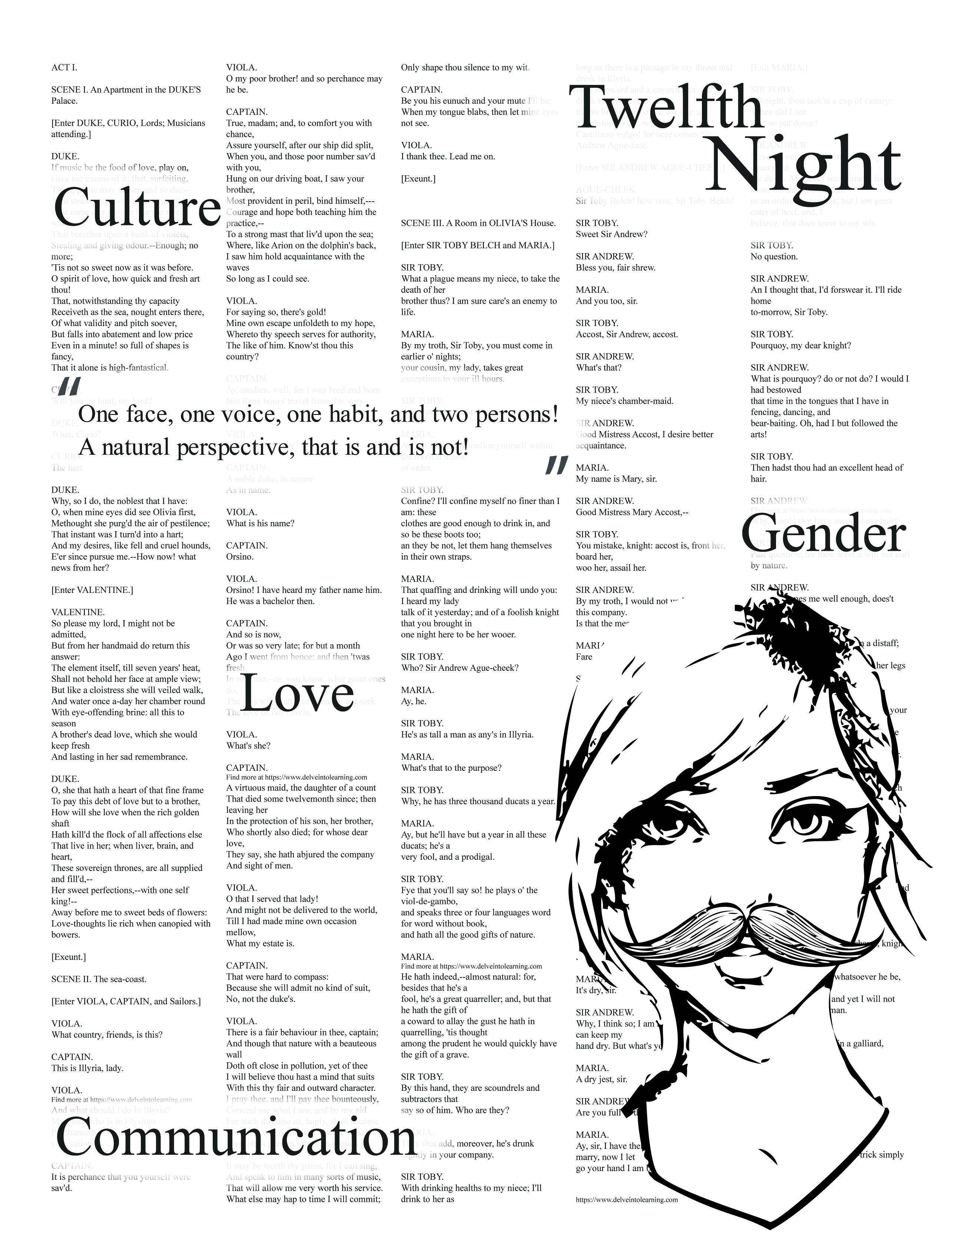
COMEDY The Twelfth Night, or What You Will by William Shakespeare

Slide 7
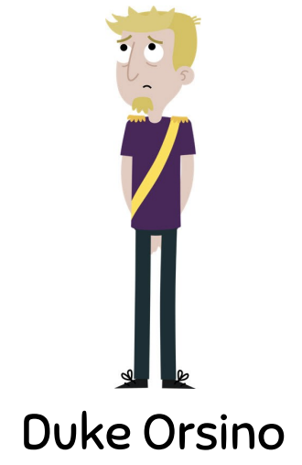
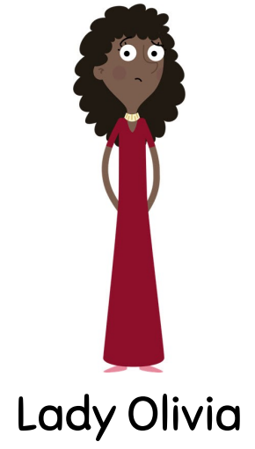
What are the main characters like?

Slide 8
Слово | Транскрипция | Перевод
shipwreck | [ʃɪprek] | кораблекрушение
messenger | [mesəndʒə] | посыльный
be in love |  | быть влюблённым
fall in love |  | влюбиться
mess | [mes] | беспорядок, неразбериха
duke | [djuːk] | герцог
disguise | [dɪsgaɪz] | маскировка
alive | [əlaɪv] | жив
double | [dʌbl] | двойной
wedding | [wedɪŋ] | свадьба

Slide 10
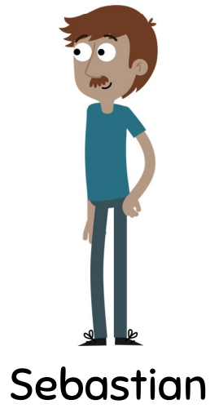
twins

Slide 11
HOMEWORK
P. 80 EX.7
P. 81 EX.11

Slide 12
Thank you for your attention

