Slide 1
«Волшебные кольца Луллия» (настольная дидактическая игра для детей старшего возраста)

Slide 2
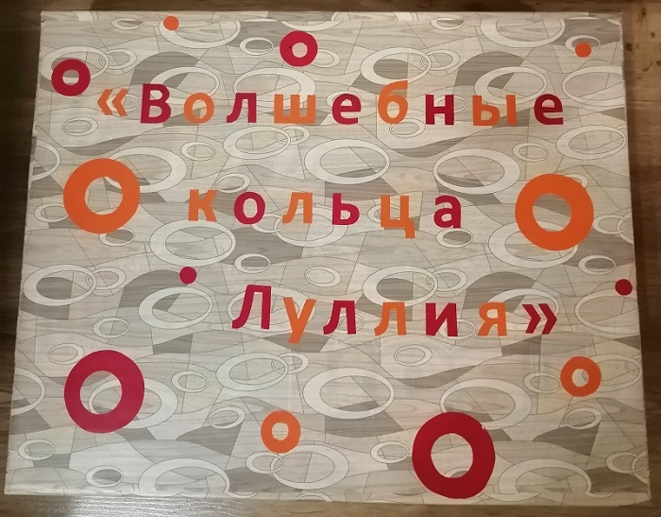

Slide 4
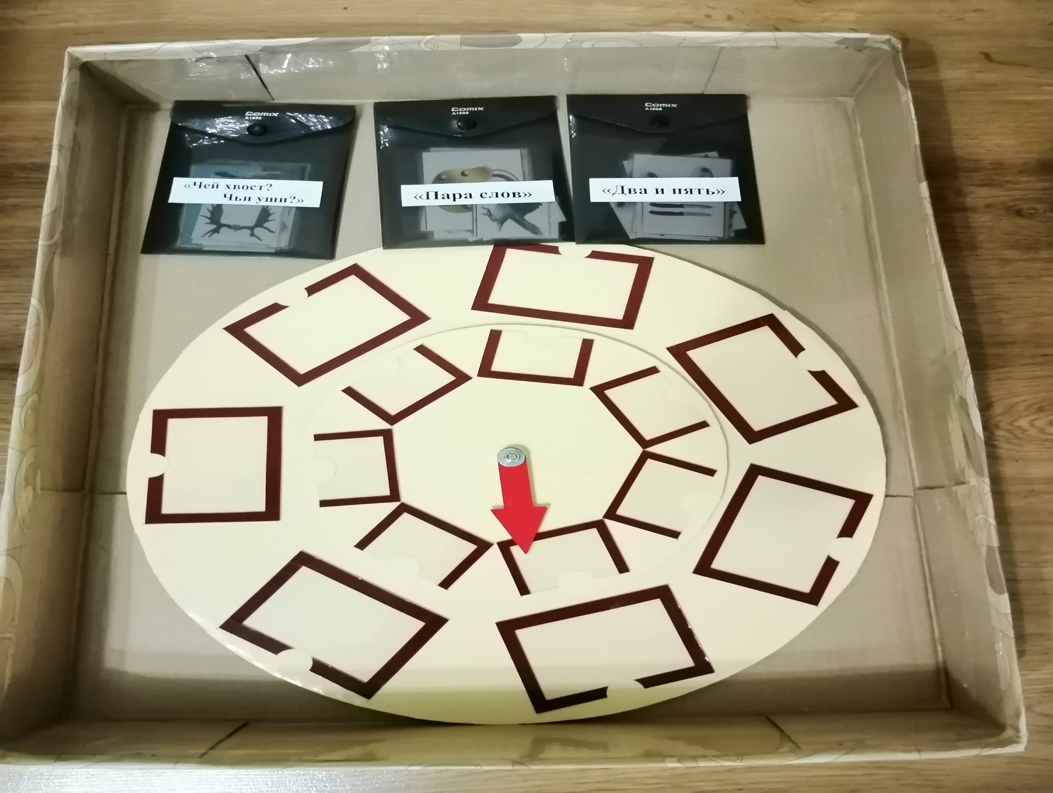

Slide 5
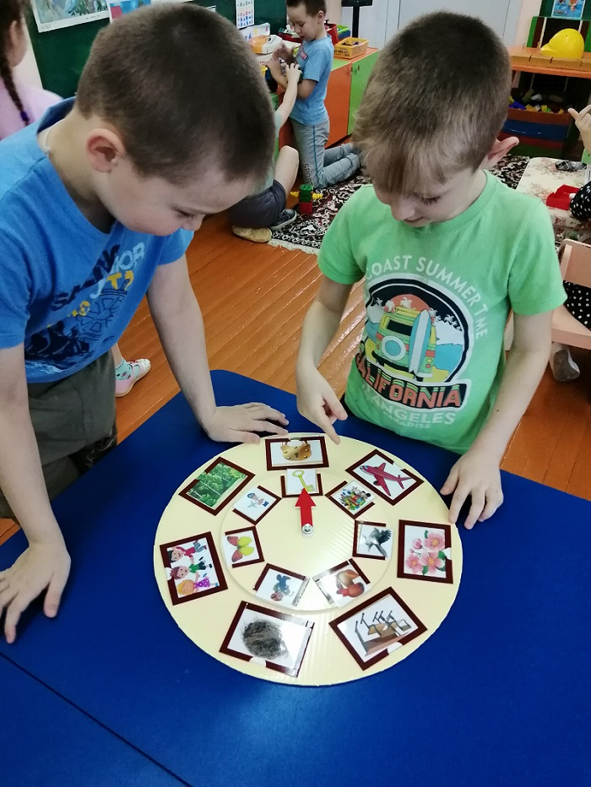

Slide 6
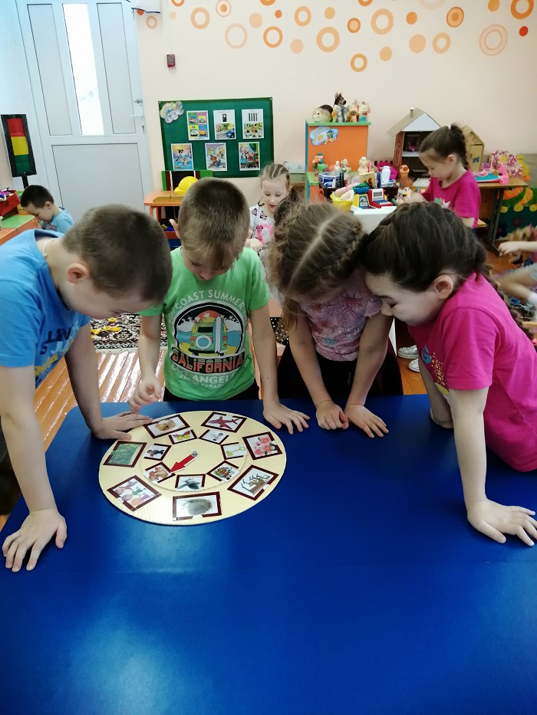

Slide 7
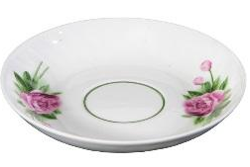
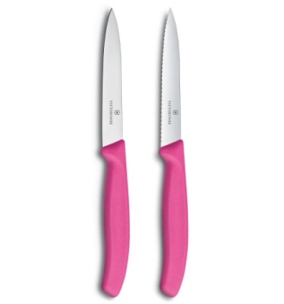
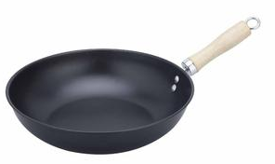
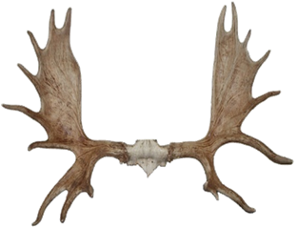
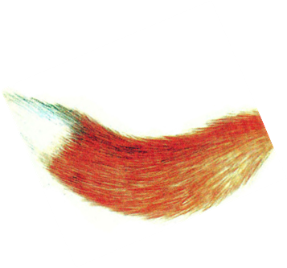
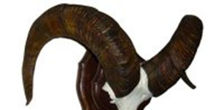

Slide 8
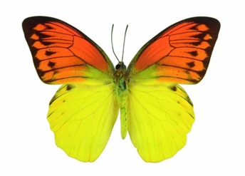
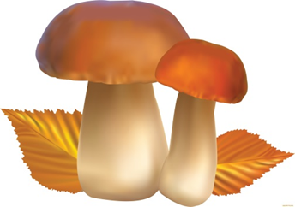

Slide 9
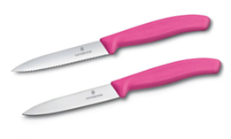
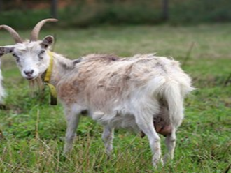
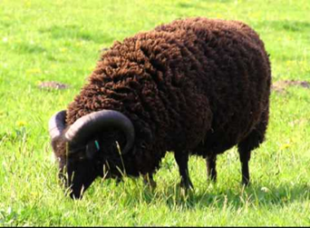
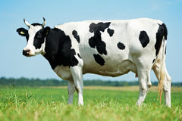

Slide 10
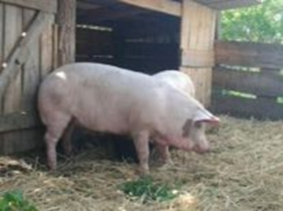
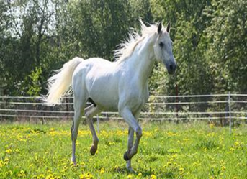
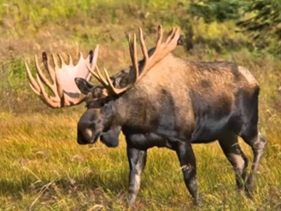
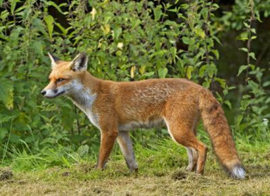
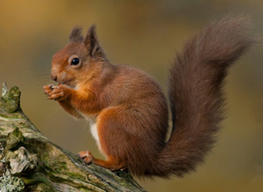
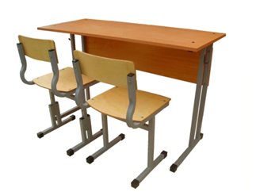

Slide 12
https://teamoll.ru/Gallery/Image/Ph3-siv8QgxyHa8Gbof19g.jpg
http://cdn.e96.ru/assets/images/catalog/kitchen_appliance/crockery/kastryuli/1442108/1442108-agness-934-203_5959310.jpg
https://fhd.multiurok.ru/8/c/6/8c6264d0268437e1d06dd70c02d9574a58b6f9e3/konspiekt-loghopiedichieskogho-zaniatiia-dlia-3-4-_4.jpeg
http://ae01.alicdn.com/kf/HTB1dfJvfYZnBKNjSZFrq6yRLFXai.jpg_q50.jpg
https://diamondelectric.ru/images/2664/2663510/noj_kyhonnii_victorinox_1.jpg
https://avatars.mds.yandex.net/get-pdb/1025945/42cfae5a-fce5-4138-ada5-585d4c4d78a8/s1200
https://img6.minus50.net/fccd3b473e08_336x224.jpg
https://i0.lbrd.ru/fileentry/get/597/08/9a/5e589f765adb95736bc6bfcdbf7e.png
https://ds04.infourok.ru/uploads/ex/0c36/0007c0dd-035d7bc1/hello_html_1daf0b9b.jpg
https://i.ytimg.com/vi/jC1poXqtoHE/hqdefault.jpg
https://foto.hastane.com.tr/galeri/2015/08/12/nehir-canavarlari_x_26023_o.jpg
http://funnyhorse.pictures/images/phocagallery/cute/thumbs/phoca_thumb_l_cute-horse.jpg

Slide 13
https://69.img.avito.st/image/1/bMxRMba3wCVHkXolBXRE98qSwCPzksAjlPE
https://i.pinimg.com/736x/65/16/fe/6516fe8453e1429d3f611a4e3c505d5b--cute-clipart-bia.jpg
https://avatars.mds.yandex.net/get-zen_doc/1900370/pub_5ca71fc973462700b2280eb9_5ca72054acc64a00b30a89c6/scale_1200
https://avatars.mds.yandex.net/get-pdb/1751208/a3090770-c072-4844-89c9-3c35ef4054ba/s1200
https://media.istockphoto.com/photos/empty-nest-picture-id184104981?k=6&m=184104981&s=612x612&w=0&h=z4V3_Qnxv4KUuFxvVWvUi-ZWfPyZMMNt_lFaM_p4HWU=
https://i.pinimg.com/736x/70/c5/b3/70c5b3ba1a0490761ac8aeda09f3ddd4--hibiscus-flowers-art-flowers.jpg
http://images.clipartpanda.com/pilot-clipart-TN_airline-pilot-standing-with-arms-crossed-clipart-5181.jpg
http://zabavnik.club/wp-content/uploads/Kartinki_pro_samolet_6_14205547-1024x576.jpg
https://forum.optina.ru/uploads/profile/photo-thumb-2426.jpg

Slide 14
https://pickimage.ru/detskie-risunki/vospitatelya-s-detmi-na-prozrachnom-fone/
https://avatars.mds.yandex.net/get-pdb/216365/950635f9-5136-412a-ae5e-fb79f11936b1/s1200?webp=false
https://i.artfile.me/wallpaper/26-09-2017/3569x2352/vektornaya-grafika-eda--food-listya-osen-1237744.jpg
https://pickimage.ru/wp-content/uploads/images/detskie/forest/les10.jpg
https://legitworkonlineforreal.com/wp-content/uploads/2018/01/Screenshot_2018-08-14-02-02-20-1024x576.png
http://img2.3png.com/2013a6131dd75f0877b6ae57006069fa59a2.png
https://gorod.sumy.ua/image/news/2014/2014_10/charivnuk/6Pi_hLpDcks.jpg
https://thumbs.dreamstime.com/b/princess-%D0%B1%D0%B0%D0%B1%D0%BE%D1%87%D0%BA%D0%B8-25387017.jpg
http://redsuvenir.ru/images/products/OASIS/829834_a.jpg

