Slide 1
Watch a short video film and tell me what we are going to talk about during this lesson

Slide 2
Leisure time activities and personalities

Slide 3
The Macmillan Dictionary gives the definition of the word “leisure”
Definition:
Leisure - a noun
Leisure is time when you are not working and you can relax and do things that you enjoy.
Eg. What do you do in your leisure time?

Slide 4
«All work and no play makes Jack a dull boy»
Our slogan

Slide 5
Match the columns to get a word collocation
1 | household | A | spree
2 | bus | B | money
3 | student | C | bills
4 | pocket | D | fares
5 | shopping | E | loan
My brother took out a …. to go to university.
….. seem to be going up all the time. I think I’ll cycle to work
in the future.
Many consumers go on a …. at Christmastime.
I’m always broke after paying the … at the end of the month.
If I don’t help around the house, I don’t get any … .

Slide 6
Answer the questions
Leisure time is such a fascinating time, isn’t it? Why?
How much leisure time have you got every day? Why?
Do you prefer spending your free time in social networks to meeting your friends eye-to-eye?
Are you an active or a passive type of person? Why?
-Have you got your favourite pastime? What is it?

Slide 7
Which of the activities do you do/play/go?
go
play
tennis
martial arts
skydiving
fishing
snowboarding
gardening
aerobics
archery
white-water rafting
board games
football
yoga

Slide 8
Remember !
After love, like, enjoy, prefer, hate we use Ving
I prefer playing tennis.
After would like we use to + V
I would like to play tennis.
After would rather we use + V than V
I would rather play tennis than do the dusting.

Slide 9
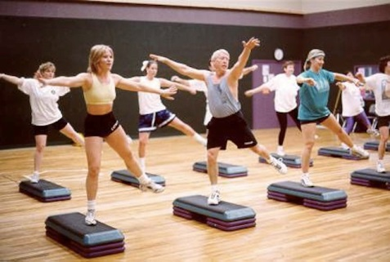
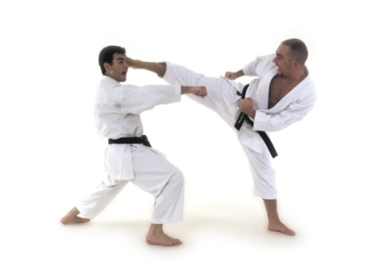
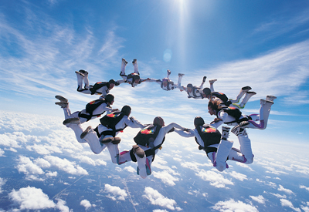
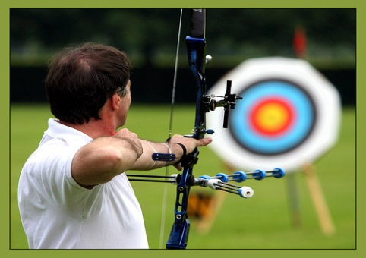
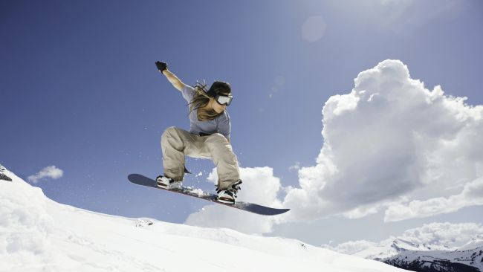
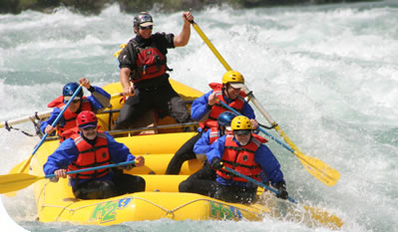
Label the pictures and complete the sentences about yourself
I prefer ….. to …. .
I’m not too keen on … .
I don’t like …. .
I really love …. but I hate …. .
I’d rather … than …. .

Slide 10
Match the personal qualities to what they mean in Russian
Boring
Ambitious
Reserved
Determined
Active
Imaginative
Sensitive
Adventurous
Brave
Cautious
Creative
Fit
Quiet
Shy
Sociable
Авантюрный
Осторожный
Творческий
В хорошей физической форме
Храбрый
Спокойный
Скромный
Общительный
Скучный
Честолюбивый
Сдержанный
Решительный
Активный
Одаренный воображением
Чувствительный

Slide 11
What kinds of people enjoy these activities?
Archery, gardening, snowboarding, fishing, skydiving, board games, martial arts, football
Example:
Fit people enjoy playing football.
boring, ambitious, reserved, determined, active, imaginative, sensitive, adventurous, brave, cautious, creative, fit, quiet, shy, sociable

Slide 12
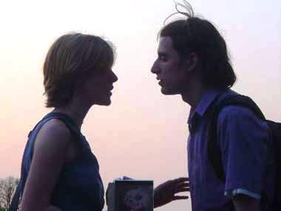
Asking about/ expressing preferences
Asking about preferences | Expressing preferences
Do you prefer … to … (+ Ving) Would you rather … (+ to + V) or … ( + V) Do you like … more than … (+ Ving) | Well, I really like, love, hate … (+ Ving) I’m not keen on/I don’t like … I prefer … to …
A: Do you prefer playing football to playing board games?
B: Well, I’m not keen on playing football. I prefer board games. What about you?
A: As for me, I really like going snowboarding.
Do aerobics
Do gardening
Go snowboarding
Go fishing
Do archery
Play tennis
Go white-water rafting
Go skydiving

Slide 13
Listen to the dialogue and mark the statements A-G T (true), F (false), NS (not stated)
Andrew has been to the community center before.
He doesn’t have a mobile phone.
There aren’t many activities offered at the community center.
Andrew wants to take up basketball.
He has never tried kick boxing before.
He wants to start at the beginning of September.
The classes cost ten pounds for 35 lessons.
Statement | A | B | C | D | E | F | G
Answer

Slide 14
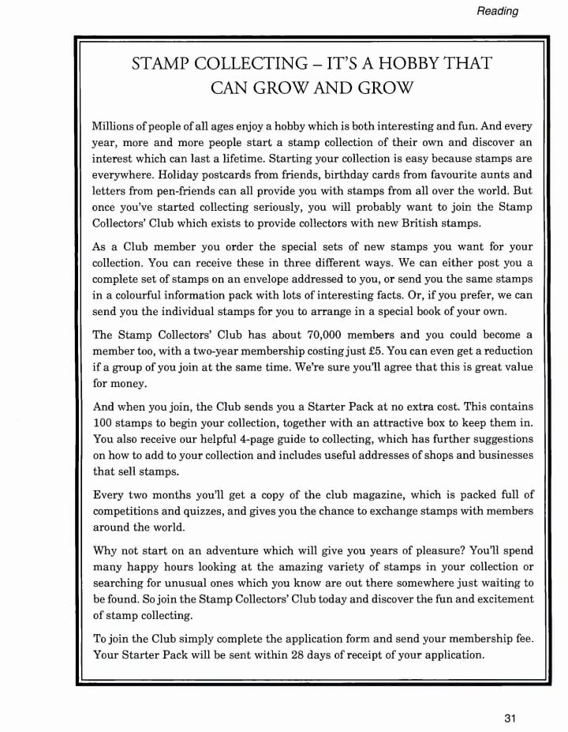
Read the text and mark the sentences
A (correct), B (incorrect)
1. The Stamp Collectors’ Club sends you special stamps from many different countries
2. The Club sends every member the same set of new stamps.
3. Information packs include a full set of stamps.
4. It costs 5 pounds a year to join the Stamp Collectors’ Club.
5. It is cheaper if several people join the Club together.
6. The Club sends each new member a hundred free stamps.
7. The guide tells you where you may be able to buy the stamps they want.
8. Members of the Club are sent a monthly magazine.
9. You must write a letter to the Club if you want to join.

Slide 15
Your home task
Задание 1 уровня (базовый) – выполнить упр. 1, 2 с. 13 в
рабочей тетради.
Задание 2 уровня (повышенный) – написать сообщение на тему
«My favourite pastime»
s

Slide 16
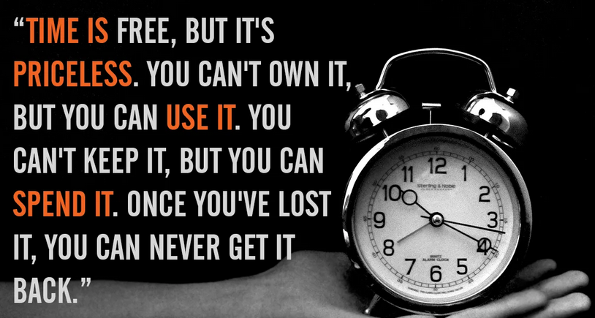
Time is free,
but it is priceless.
You can’t own it,
but you can use it.
You can’t keep it,
but you can spend it.
Once you’ve lost it,
you never get it back…
Harvey Mackay)

Slide 17
of course
“Not only work but also play”
but remember
“Business before pleasure”

Slide 18
Thank you for the lesson

