Slide 1
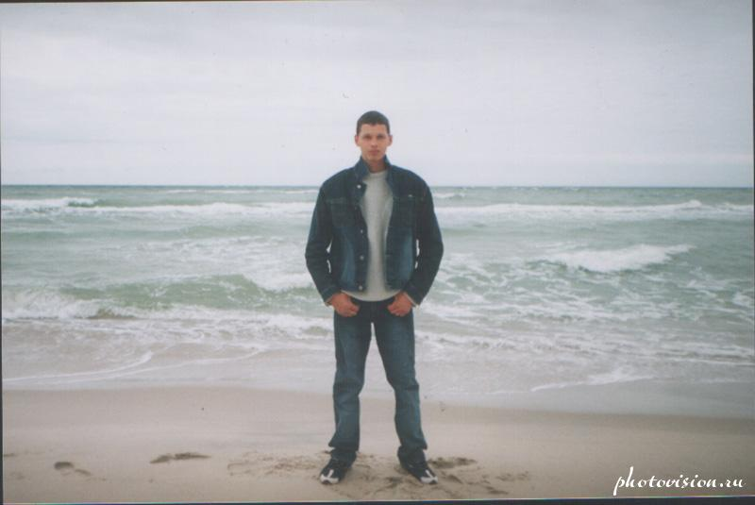
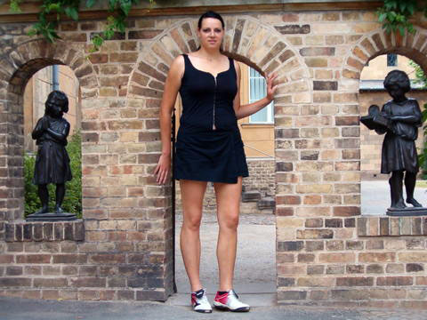
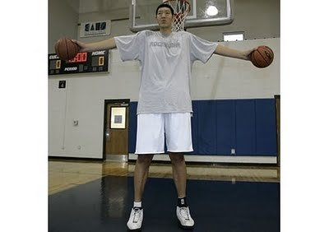
tall
taller
tallest
Nick Jill Jim

Slide 2
Nick is tall.

Slide 3
Jill Nick

Slide 4
Jim Jill

Slide 5
Jim Nick

Slide 6
Nick Jill Jim

Slide 7
Jane Peter Kate

Slide 8
Bob Tom Billy Max

Slide 9
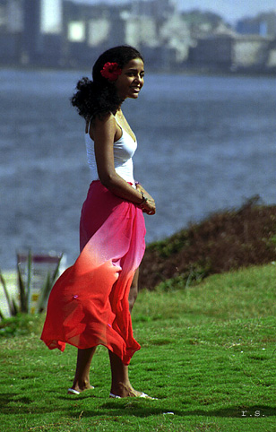
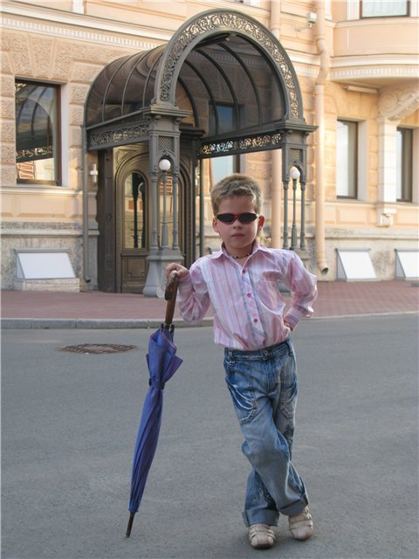
short shorter shortest
Mary Tiny Helen

Slide 10
Tiny Mary

Slide 11
Helen Tiny

Slide 12
Mary Tiny Helen

Slide 13
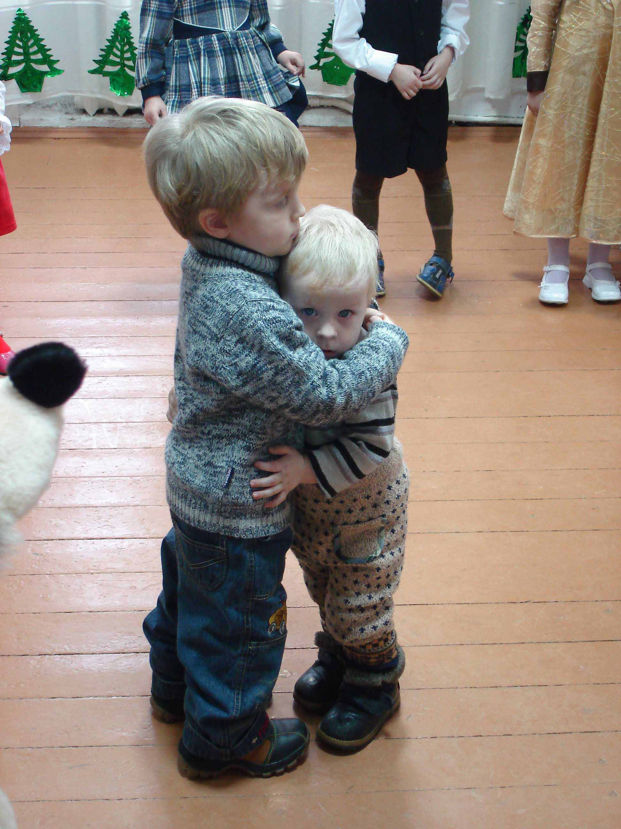
Bob Tim Peter Nick

Slide 14
strong stronger strongest
Mark Denis Tom

Slide 15
Denis Mark

Slide 16
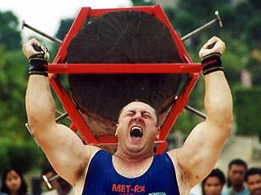
Jack Alex
Jack is stronger than Alex./
Alex is stronger than Jack.

Slide 17
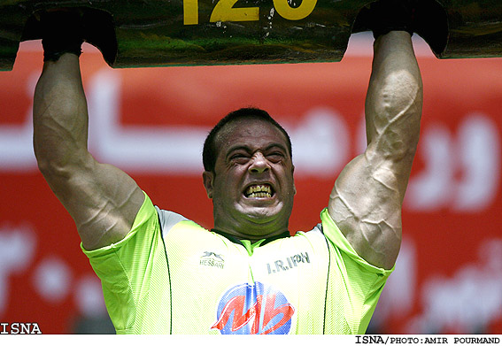
Tom Denis Mark

Slide 18
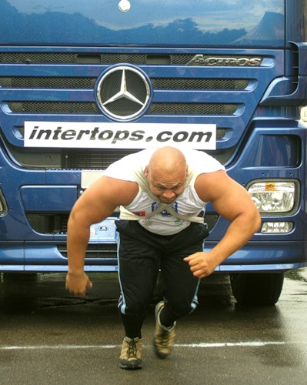
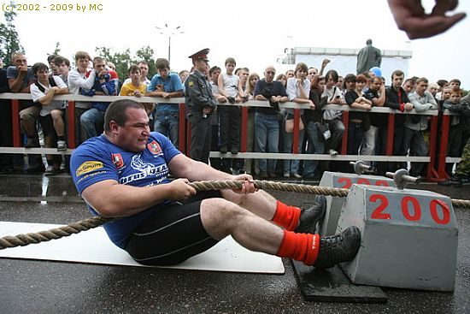
Ben is (the) strongest./ Bill is (the) strongest./ Rick is (the) strongest.
Ben Bill Rick

Slide 19
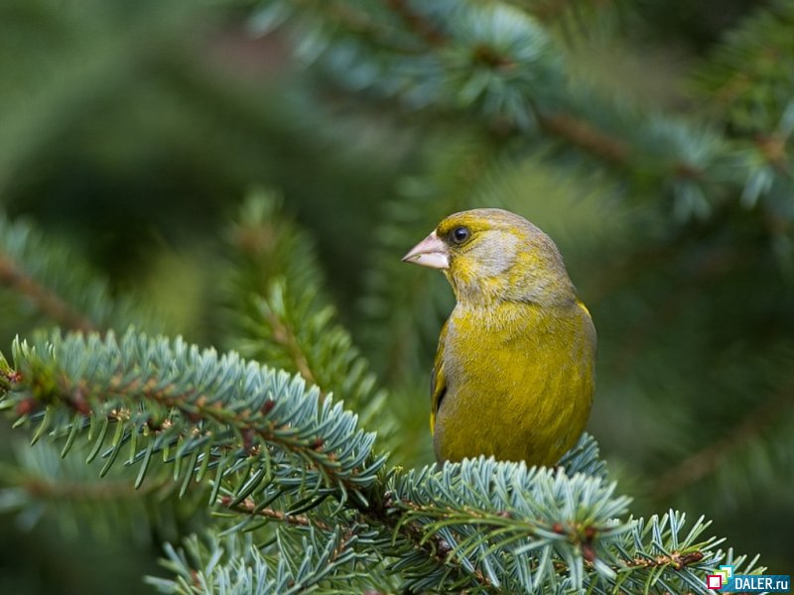
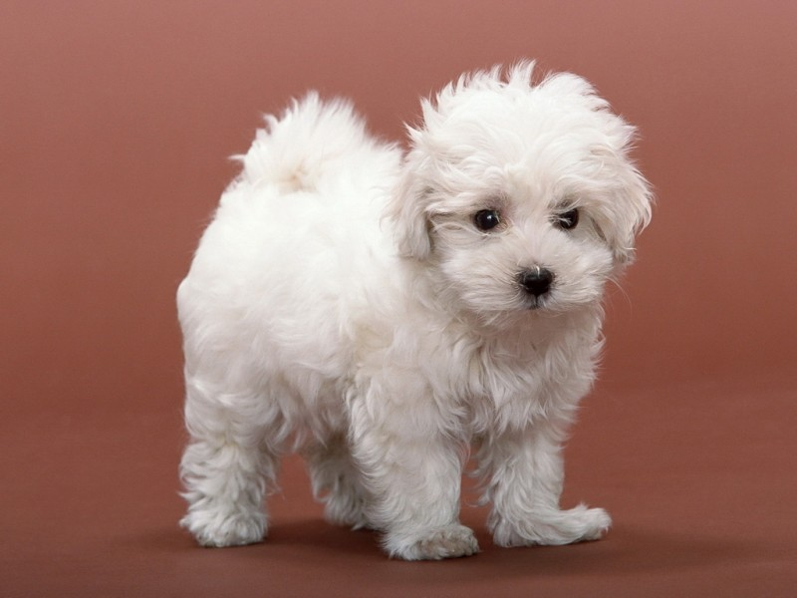
The dog The cat The bird

Slide 20
The cat The dog

Slide 21
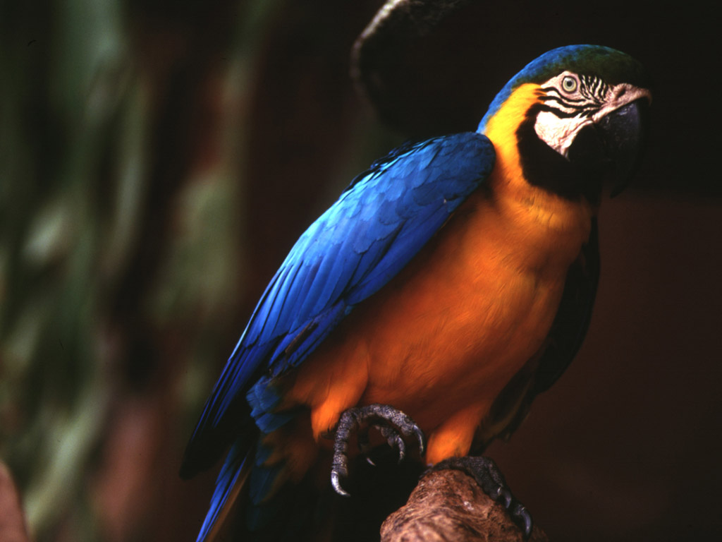
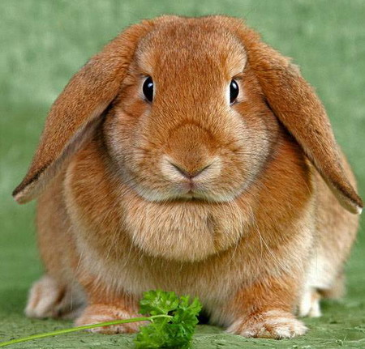
The parrot
The rabbit

Slide 22
… is (the) smallest.
The bird
The cat
The dog

Slide 23
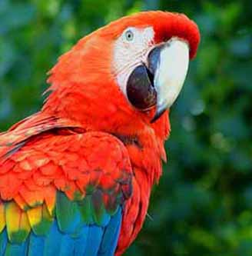
The frog is (the) smallest.
The frog The parrot The mouse

