Slide 1
DESCRIBING A PERSON

Slide 4
Who are you going to describe?
Alex, my uncle
How long you known him/her?
all my life
What does he/she look like?
short, black hair, beard
What does he/she like?
football, dogs
What is he/she like?
honest, shy, reliable

Slide 5
APPEARANCE
white hair -lots of make-up
clear, blue eyes -short - thin
CHARACTER
cheerful-always smiling
generous -helpful
MY GRANDMOTHER
RELATIONSHIPS
popular with neighbours
often baby-sits
argues with grandad
LIKES
talking, esp. gossip
animals, esp. dogs
loves children
DISLIKES
TV (except films)
junk food

Slide 6
111
11
11
111
11
11
22

Slide 7
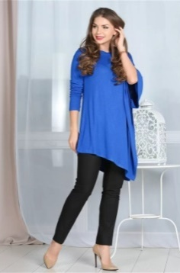
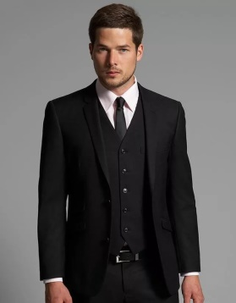
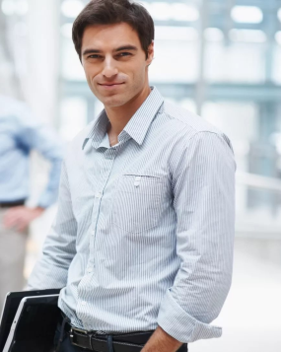
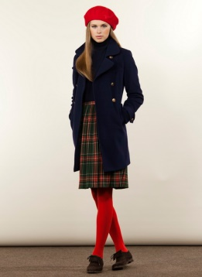
1 2 3 4 5
6 7 8 9 10
11 12 13 14 15

Slide 8
1

Slide 9
2

Slide 10
3

Slide 11
4

Slide 12
5

Slide 13
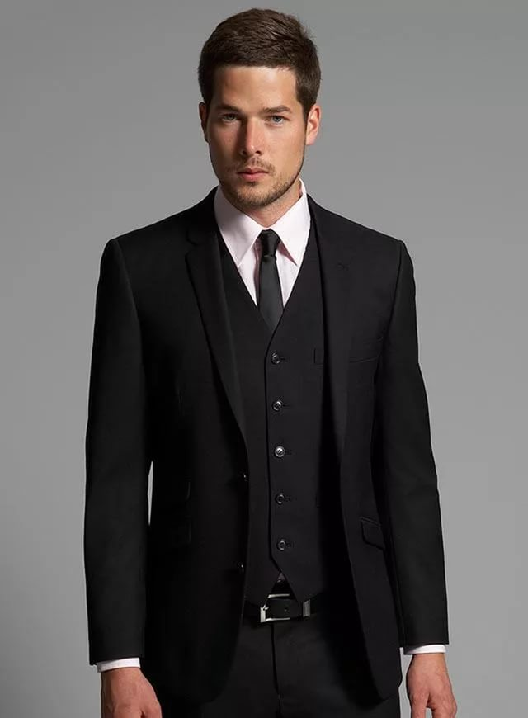
6

Slide 14
7

Slide 15
8

Slide 16
9

Slide 17
10

Slide 18
11

Slide 19
12

Slide 20
13

Slide 21
14

Slide 22
15

Slide 23
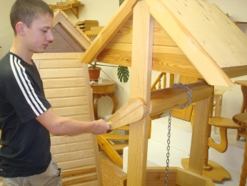
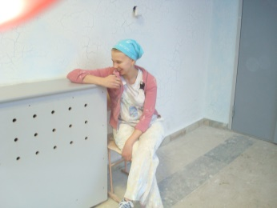
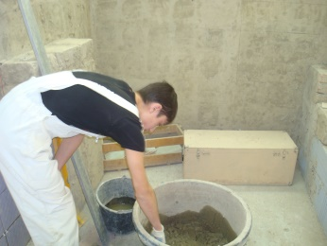
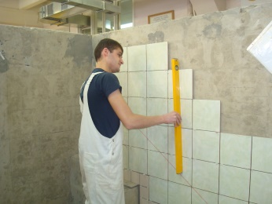
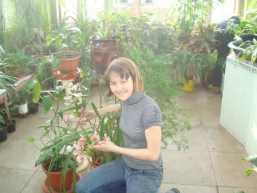
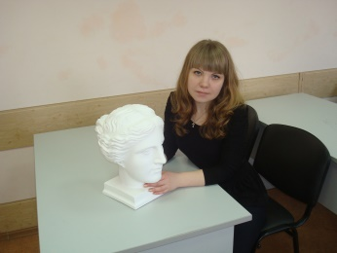
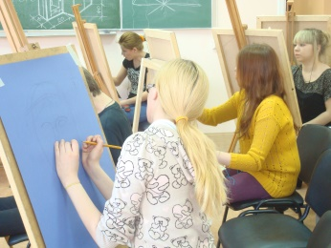
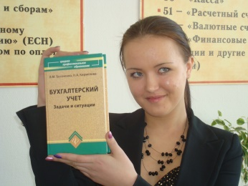
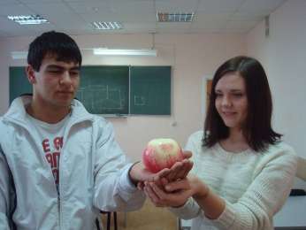
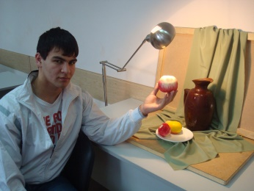
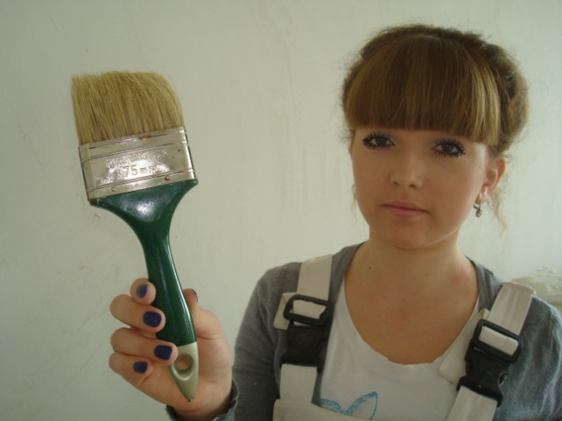
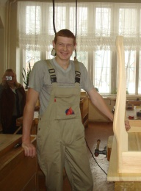
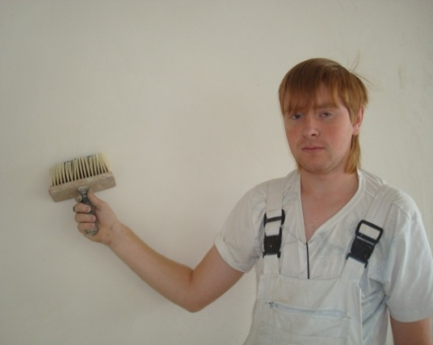
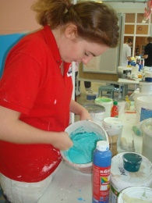
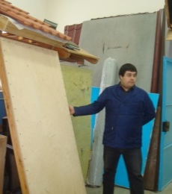
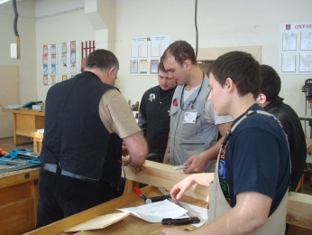
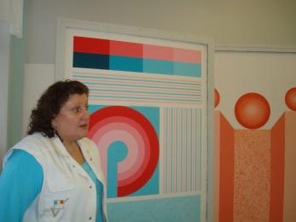
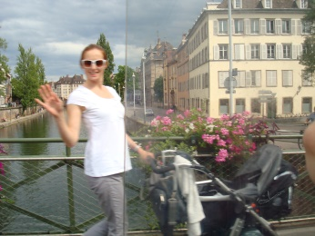
16 17 18 19 20
21 22 23 24 25 26
27 28 29 30 31 32 33

Slide 24
16

Slide 25
17

Slide 26
18

Slide 27
19

Slide 28
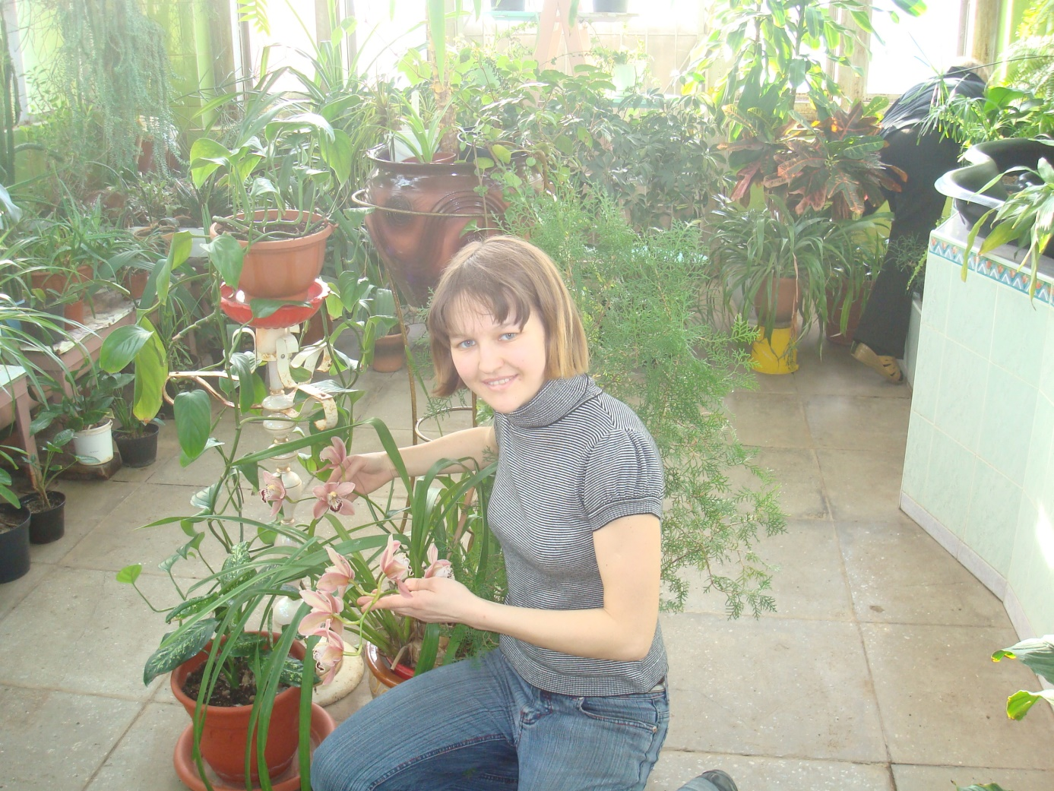
20

Slide 29
21

Slide 30
22

Slide 31
23

Slide 32
24

Slide 33
25

Slide 34
26

Slide 35
27

Slide 36
28

Slide 37
29

Slide 38
30

Slide 39
31

Slide 40
32

Slide 41
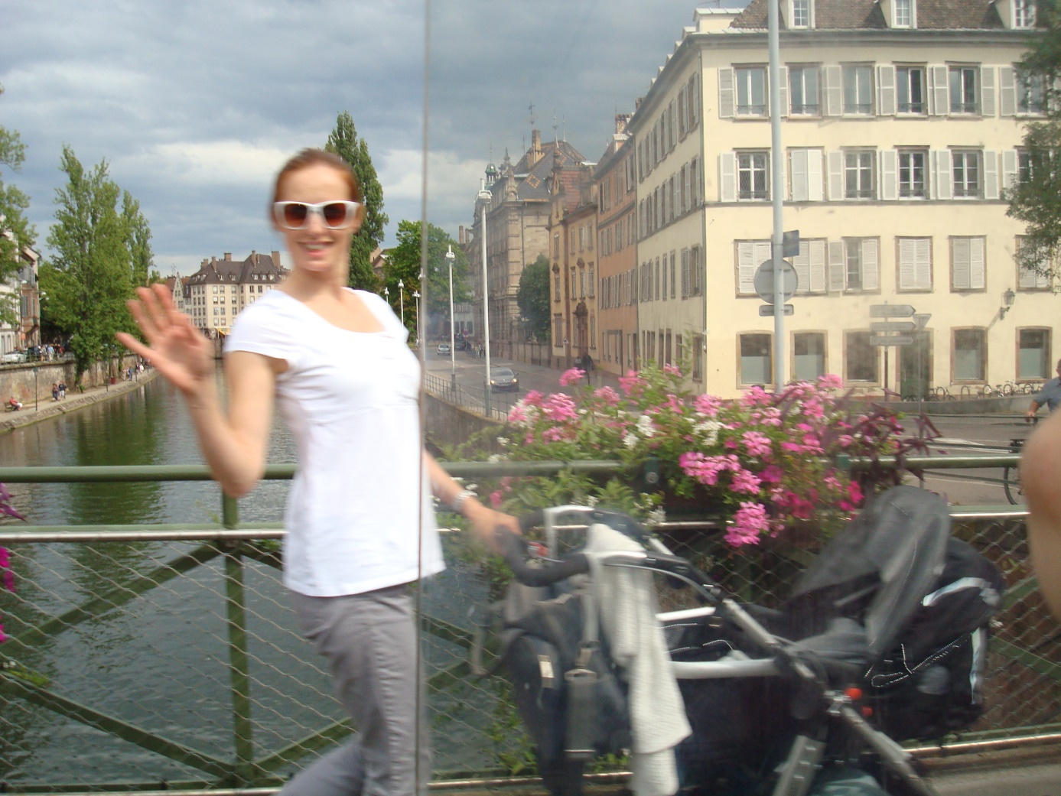
33

