Slide 1
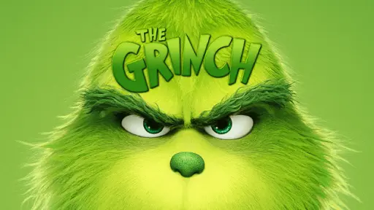
With fun and profit

Slide 2
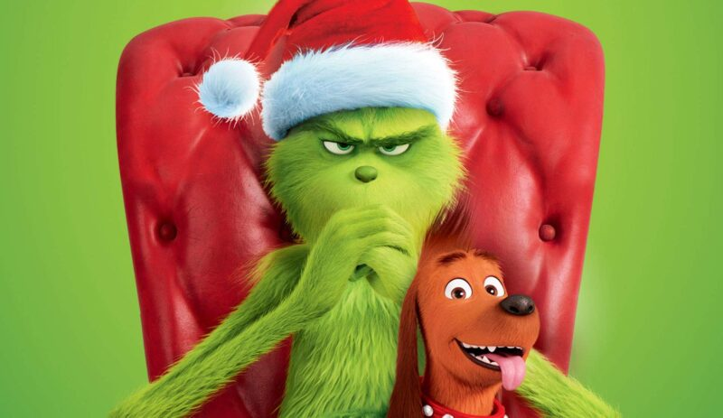
Describe the Grinch and his pet Max, using following words:
mean, scary, happy, bad banana, heel, funny, clever, vile, foul, monster, nice, amazing, kind, boring, cool, great, genius, tricky, sweet, careful, gorgeous

Slide 3
Grammar point. Comparing people and things
Like – подобно, как. (указывает на сходство и служит больше для описания. Обычно стоит после глагола и перед существительным либо местоимением.
For example:
1. It’ s a town like your town.
2. Smells like Christmas.

Slide 4
Grammar point. Comparing people and things
As используется в сравнительной конструкции as ... as (такой же, как) или not as ... as (не такой, как)
For example:
As cuddly as a cactus.
As charming as an eel.

Slide 5
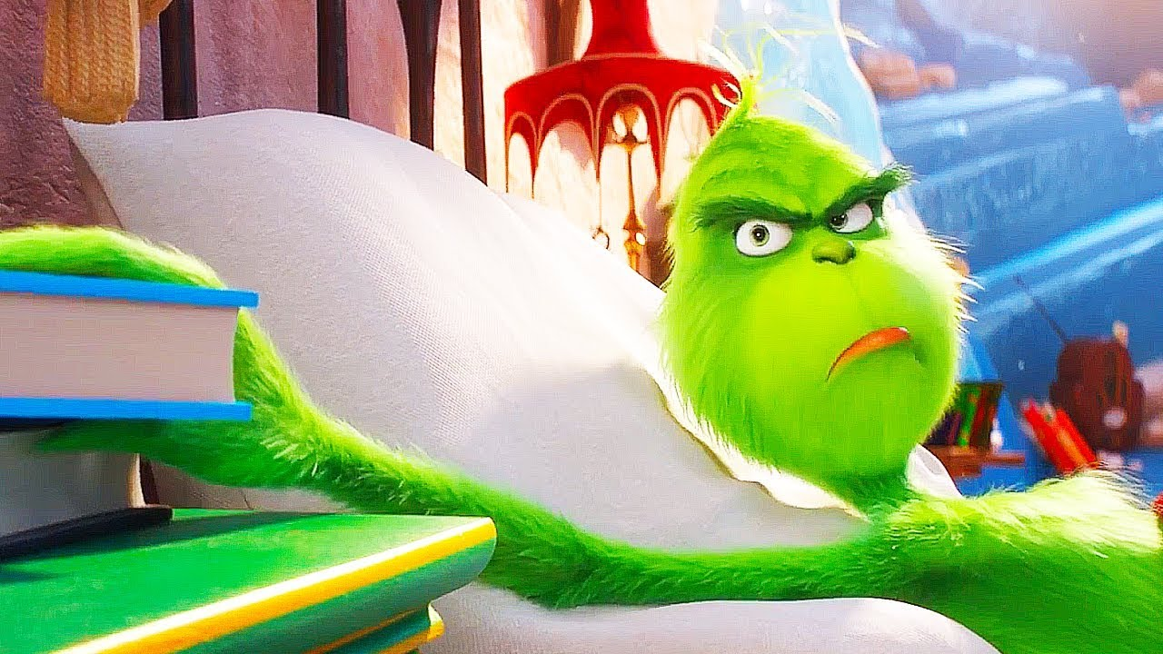
В чем же разница между as и like:
Let’s look at examples and get to know:
As your teacher, I insist on doing the hometask. — Как твой учитель, я настаиваю на выполнении домашнего задания.
Like your teacher, I insist on doing the hometask. — Как и твой учитель, я настаиваю на выполнении домашнего задания.
В первом предложении as обозначает: "в качестве, в роли", во втором примере like передает значение: "подобно, похоже".
Make your examples with following phrases:
like snowball like concrete more like a wish like the Grinch
like Cindy Lou like spring like a snowman like holiday
as big as as gorgeous as as cold as as vile as
as scary as as great as as small as as funny as

Slide 6
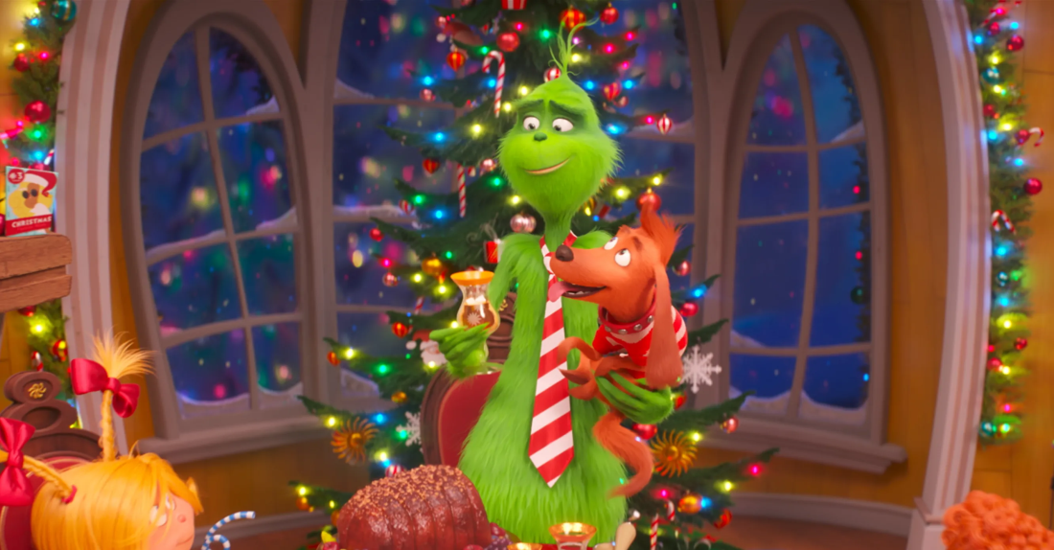
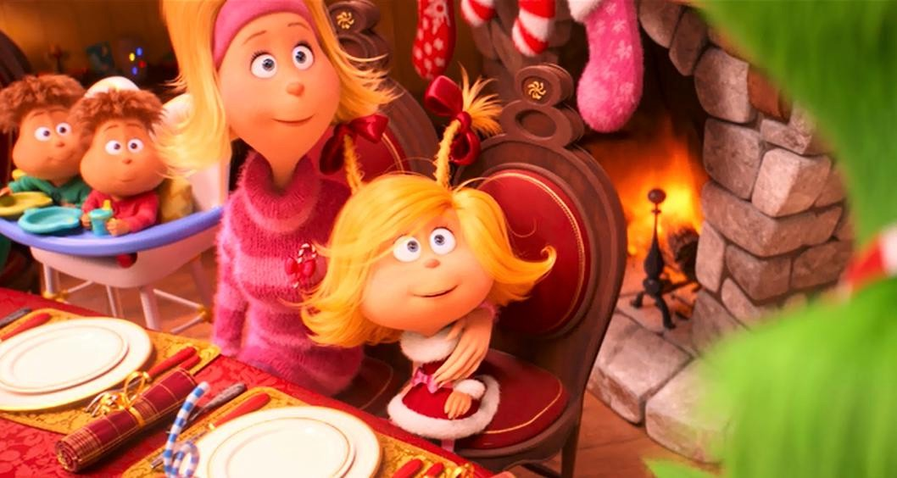
На что же заменяют носители языка слово “VERY”? Они заменяют его на REALLY, которое несет то же самое значение: очень, в самом деле.
Examples:
It’s really personal.
It’s really important.
It’s really big.
He is really funny.
He is really bad banana.

Slide 7
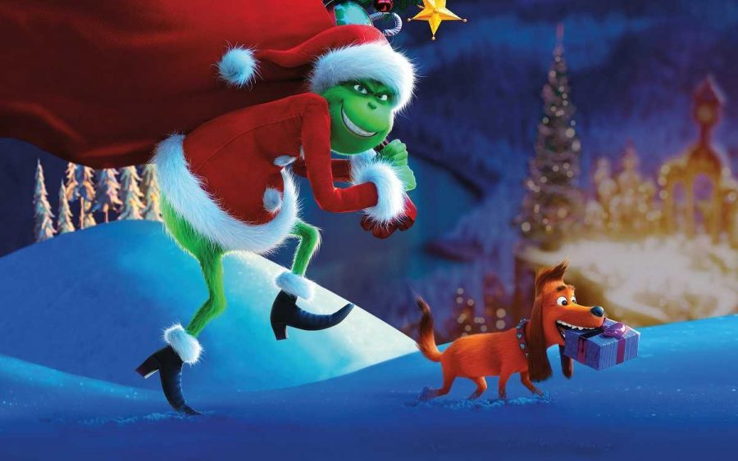
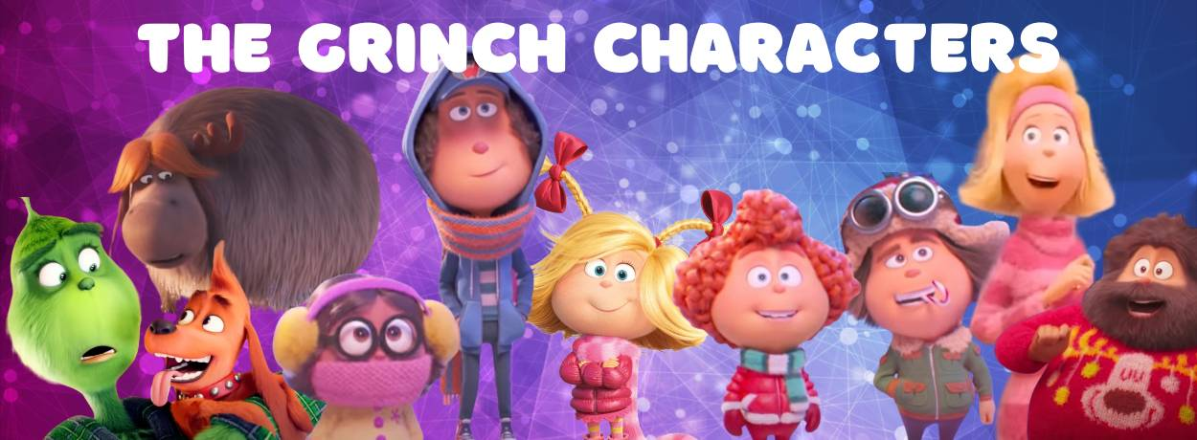
The Grinch has got | The Whose have got
awful idea good mood pet Max New Year’s Trees
family broken heart presents lots of decorations
organ house cave lot’s of bells
green clothes red armchair loads of snowballs

Slide 8
This isn’t a letter, this is the letter.
What is the difference between “a letter” and “ the letter”? How can you translate it?

Slide 9
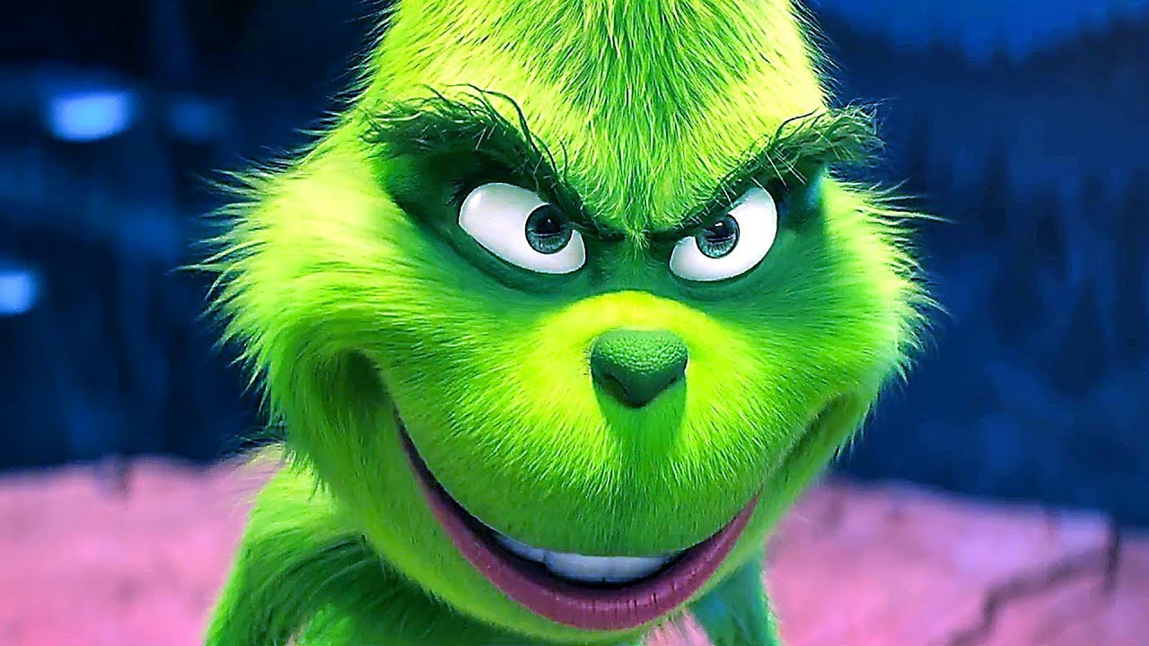
Phrases to learn and make sentences
A list of errands a mile long – длинный список дел
My bad – Мой косяк. / Моя вина
I don’t mind – Я не против. / Мне не сложно.
To be out of something – закончиться, остаться без чего-то
To give a hug – обниматься
To invite somebody – приглашать кого-то
To get rid of something – избавляться от чего-то
I kind of thought – у меня мелькнула мысль

Slide 10
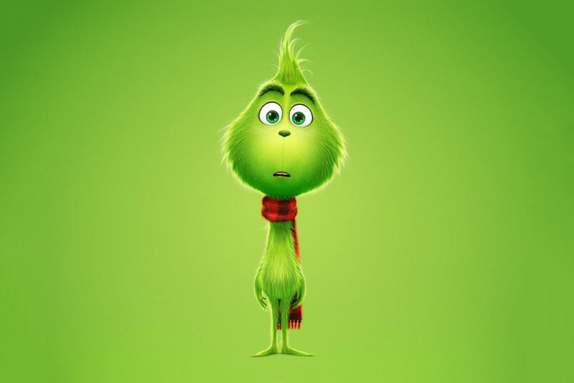
Hello. My name’s Grinch. Let’s create a New Year’s Story together. What have we got for New Year’s Day? What do we usually do?
trimmings trippings fireworks hugs New Year’s Tree
dancing games champagne postcards presents
to laugh to have fun to watch movies/cartoons
to give presents to dance to congratulate other people

Slide 11
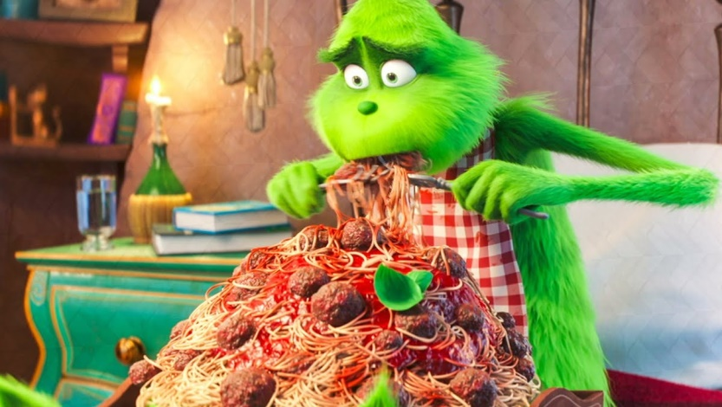
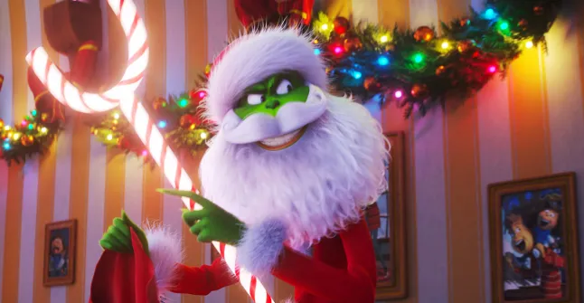
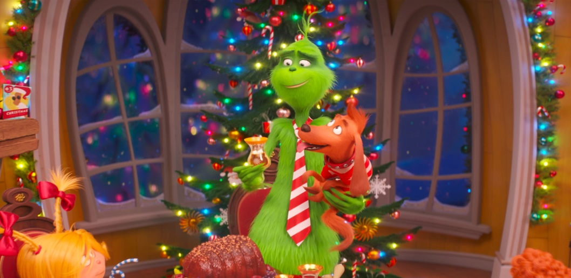
Choose what Grinch are you during New Year’s holidays?
Depressed and eating all the time
A bad banana
Friendly and happy

Slide 12
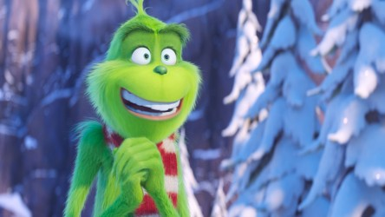
Thanks for watching!

