Slide 2
Love is life. And if you miss love, you miss life.
(Leo Buscaglia).

Slide 3
True love stories never have endings.
(Richard David Bach)

Slide 4
It is never too late to fall in love. (Sandy Wilson)

Slide 6
St. Valentine's Day
There are some legends about St. Valentine's Day. One of the legends says that Valentine was Christian priest. He was put into prison for his teaching. He did a miracle. He helped the jailer's daughter and she could see. He wrote her letter:
"My sweetheart!
Tomorrow we’ll part forever. Thank you for your kind heart and tenderness. In this dark jail our hearts were touched by the fire of love and truth. My God bless you with wisdom and compassion.
Your Valentine ".
Now St. Valentine's Day is the day of sweethearts. People give sweets, flowers, valentines and presents to those whom they love. People buy valentines or make them themselves.

Slide 8
Cupid, the Roman god of love, is one of the earliest popular symbols of the day.
Купидон, бог любви у римлян - один из самых популярных символов любви
Valentine was a Christian priest.
Валентин был христианским священником
He lived three hundred years after the death of Jesus Christ* in the Roman Empire.
Он жил 300 лет спустя после смерти Иисуса Христа в Римской империи
He married couples contrary to the laws of the Roman Empire.
Он проводил обряд венчания вопреки Законам Римской империи

Slide 9
On February 14 Valentine was killed because he was a Christian.
14/02 Валентин был казнен, т.к был Христианином
St. Valentine's Day is now a day for sweethearts.
День Св. Валентина теперь День Всех Влюбленных
Most people send "valentines", sentimental and heartfelt greeting cards.
Большая часть людей посылает "валентинки" ,сентиментальные и чувственные открытки
Valentines can be heart-shaped or can have hearts on them.
Валентинки могут иметь форму сердца или с изображением сердец

Slide 11
Adam | Eve
Napoleon | Josephine
Tarzan | Jane
Rat Buttler | Scarlet O'Hara
Tristan | Isolda
Ruslan | Ludmila
Romeo | Juliet
Ceasar | Cleopatra

Slide 13
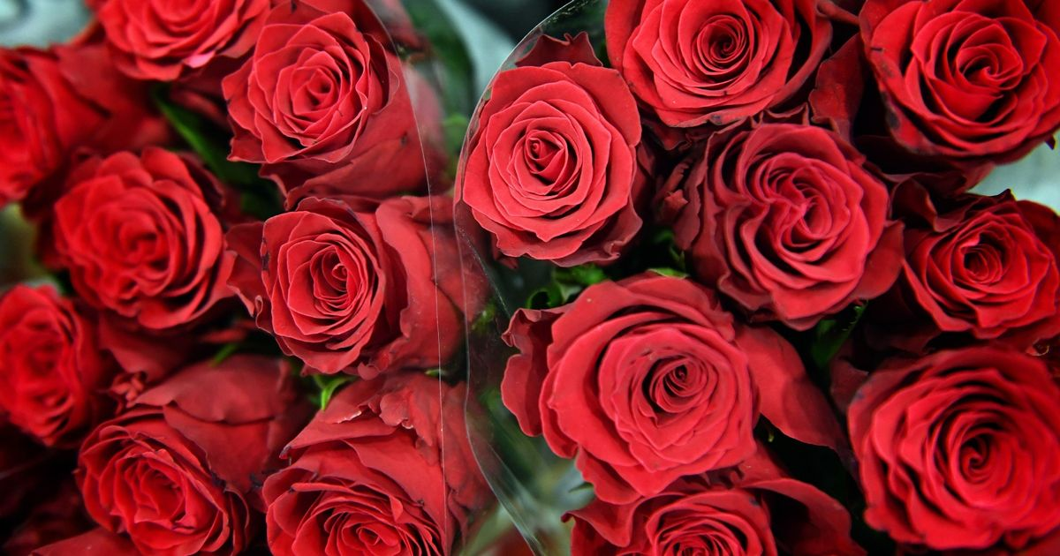
In Britain, people spent 22 mln pounds on Valentine’s Day, with traditionally romantic people buying 7 million red roses !!!

Slide 15
In the USA

Slide 17
Розы are red,
Violets are синие,
Honey is сладкий
And so are you

Slide 18
Roses are red,
Violets are blue,
Honey is sweet
And so are you.

Slide 19
Mama loves кофе,
Papa loves чай,
I люблю my teacher
And my teacher любит меня

Slide 20
Mama loves coffee,
Papa loves tea,
I love my teacher
And my teacher loves me

Slide 21
Мальчики are silly,
Девочки are smart,
I love you
With all my сердцем

Slide 22
.
Boys are silly,
Girls are smart,
I love you
With all my heart

Slide 23
Valentine’s день
Is a чудный day
To make “I love тебя”
Easy to сказать.

Slide 24
Valentine’s day
Is a lovely day
To make “I love you”
Easy to say.

Slide 25
JIGSAW HEART GAME

Slide 26
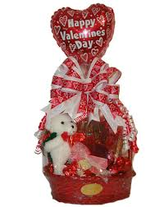

Slide 27
I want to be near you all the time and never say good-bye

Slide 29
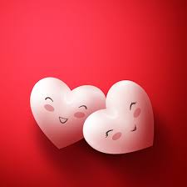
Don't forget: the best part of living is in loving and giving

Slide 30
what the world needs now is more special people like you

Slide 31
Sending a wish with lots of heart from a day that’s happy from the start

Slide 32
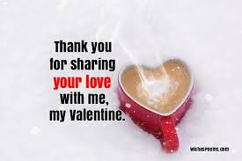
III I am wild about you
You stole my heart

Slide 33
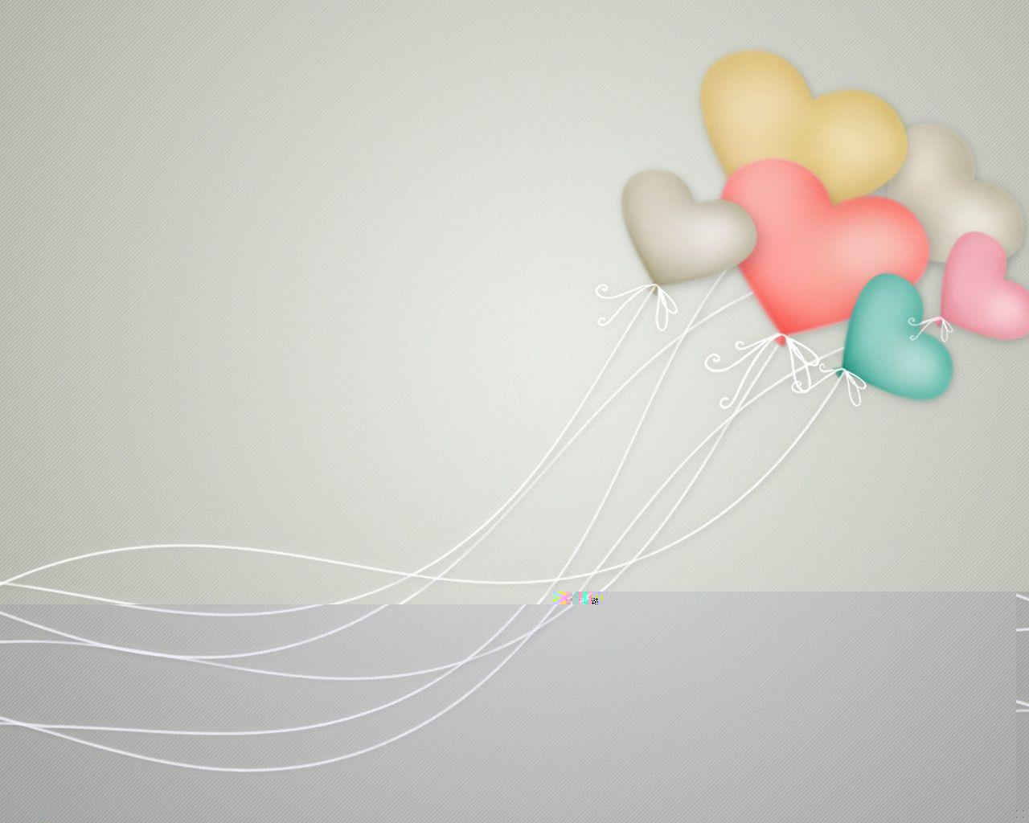
Only You* Только ты
Only you can make, oh, this world seem right, | Только ты осчастливила меня,
Only you can make the darkness bright, | Только ты в темноте светлее дня.
Only you and you alone can thrill me like you do, | Только ты, и ты одна, волнуешь вновь меня…
And fill my heart with love for only you. | Сердце вновь полно любви – любви к тебе...
Only you can make, oh, this change in me, | Только ты изменила все во мне,
For it's true - you are my destiny. | За тебя благодарен я судьбе.
When you hold my hand I understand the magic that you do | За руку взяла, и понял я: все это – волшебство...
You're my dream come true, my one and only you. | Все мечты сбылись благодаря тебе!
Only you can make, oh, this change in me, For, it's true - you are my destiny. | Только ты изменила все во мне, За тебя благодарен я судьбе.
When you hold my hand I understand the magic that you do | За руку взяла, и понял я: все это – волшебство...
You're my dream come true, my one and only you! | Все мечты сбылись благодаря тебе!

