Slide 1
The impact of Social Media on our life
Урок в рамках семинара «Критическое мышление как основа компетентностного обучения английскому языку»
26.01.2024

Slide 2
What are we going to talk about?

Slide 3
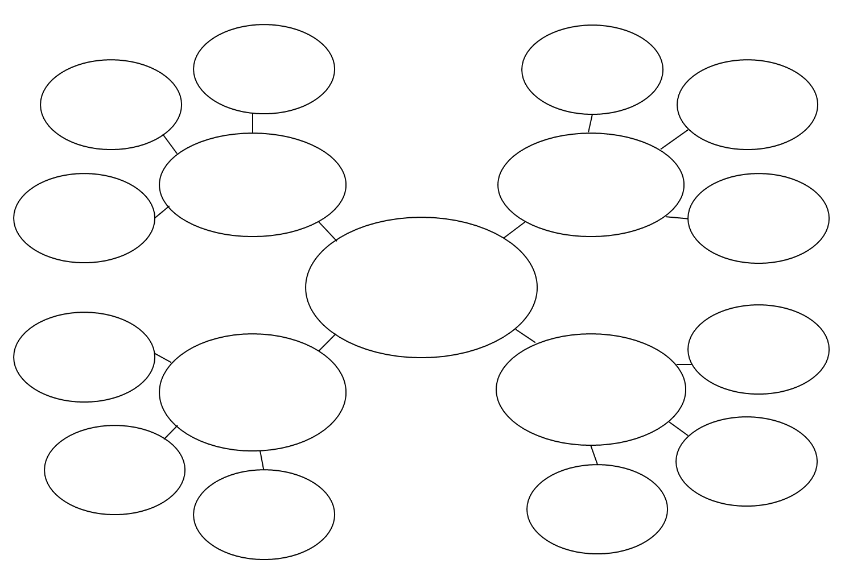
Social Media Vocabulary: filling the clusters
SOCIAL MEDIA

Slide 4
Find someone who…
…HAS BEEN TAGGED
…HAS CREATED NEW ACCOUNT…
HAS POSTED…
HAS FOLLOWED A CELEBRITY

Slide 5
Why do people use social networks?
Easy to connect
01
around the globe
02
Entertainment
Watch videos, photos, scrolling posts
Work
03
there are a lot of social media jobs nowadays
04
Education
Find the information you need
Share
05
Share the events of life

Slide 6
Negative sides of using Social Media
Social networks cause the
They take hours of scrolling
Network conversations seems to be
Addiction
Time waste
Not real
disadvantages
?
?

Slide 7
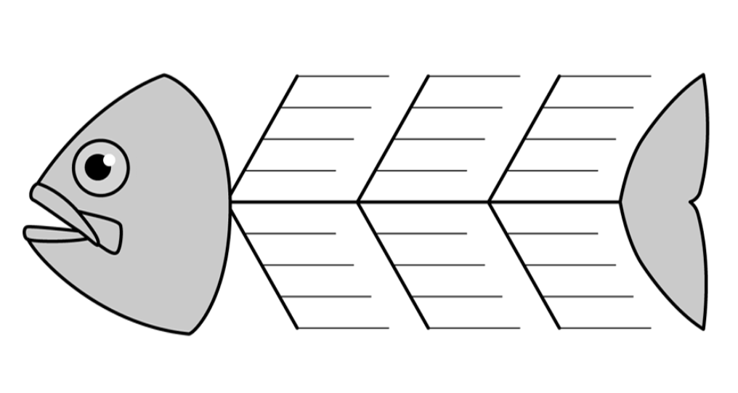
«Fishbone» Diagram

Slide 8
Summarizing
HEAD |  | BONES |  | TAIL
The problem |  | Reasons and Results |  | Conclusion
 | Social media |  | Positive and Negatives |  | ?

Slide 9
To sum up…
Defining the TAIL of Fishbone
 | To limit the using social media

Slide 10
Some tips of using social networks

Slide 11
Thanks for your attention!

