Slide 1
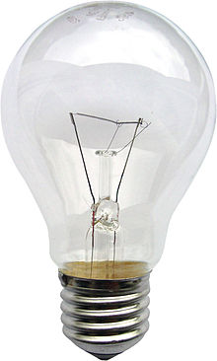
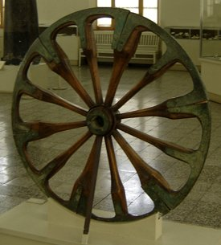
Progress and development

Slide 2
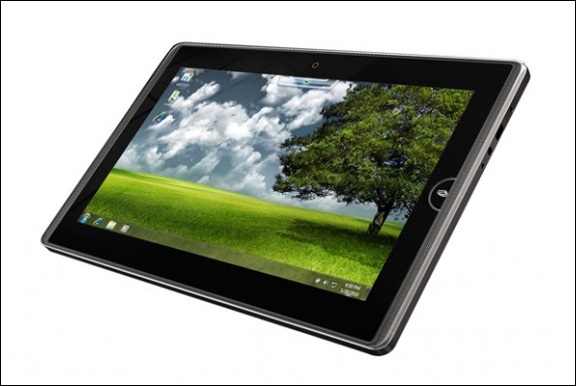
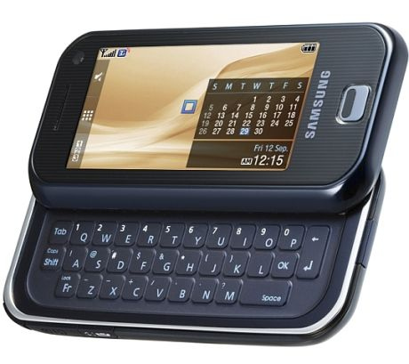
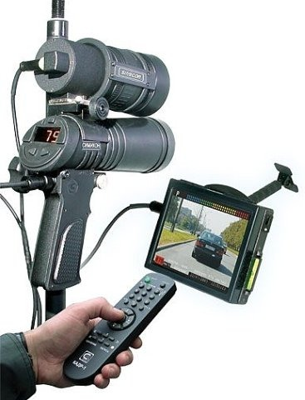
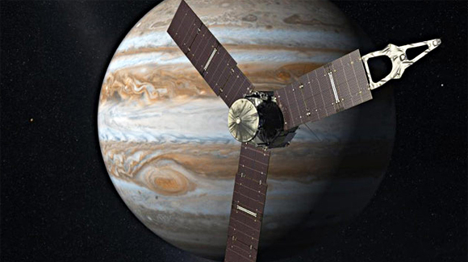
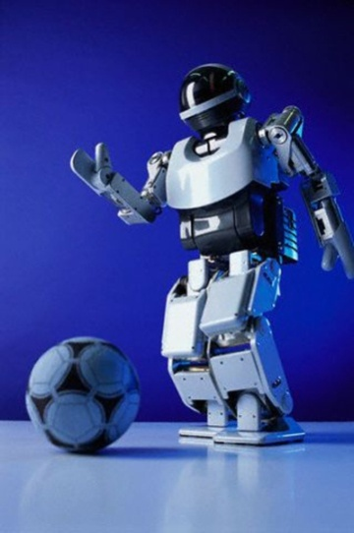
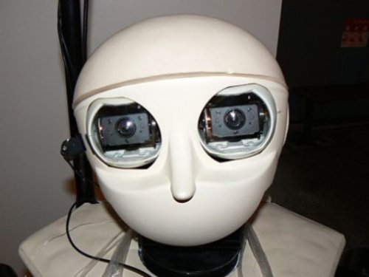
Modern Technologies and Their Influence on Our Life and Language

Slide 3
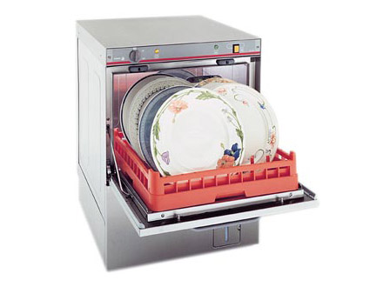
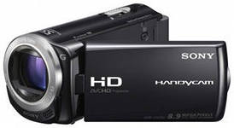
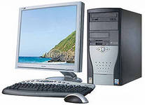
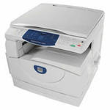
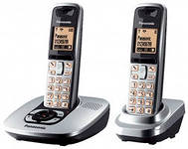
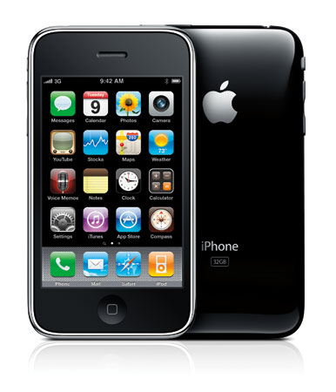
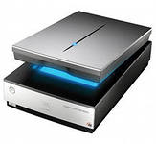
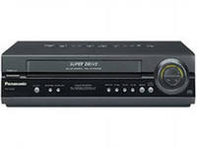
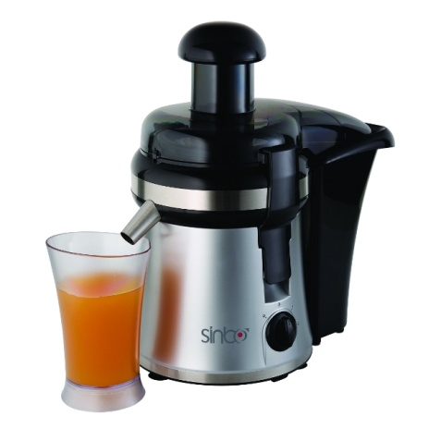
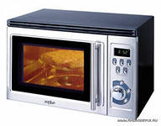
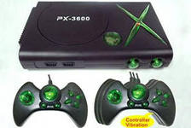
Up-to-date Inventions

Slide 4
Households
Science
Education
Technology
Communications
Entertainment
Film industry

Slide 5
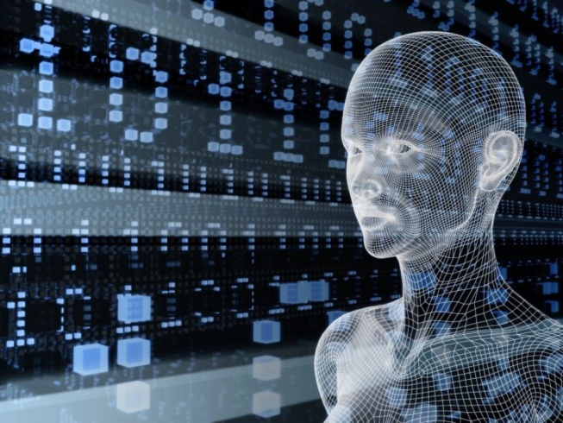
Why do people use them?

Slide 6
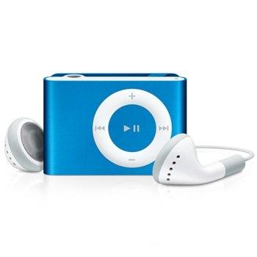
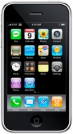
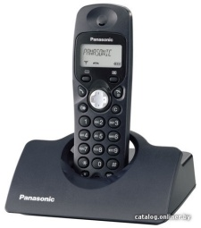
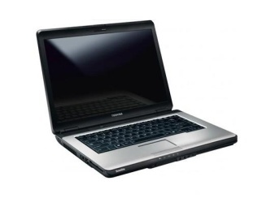
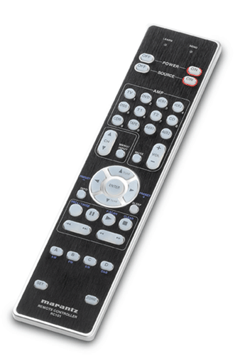
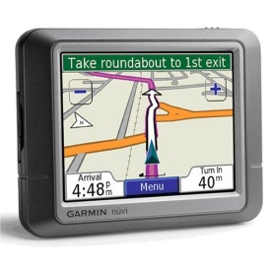
What things are the most important for you? Why?

Slide 7
We can not imagine our life without computers. What do you use computers for?

Slide 8
Are you for or against computers?

Slide 9
Benefits
- we depend on technologies in all aspects of life
- it is a source of information
- it is a way of communication
- computers are necessary tools at our workplace
- we get skills that are necessary in the information age
- it is a good friend for disabled people
- distance learning has a great importance
- it is important for security and safety

Slide 10
Drawbacks
- we spend more and more time in front of computers
- we have no time for sport activities and become lazy and passive
- there are a lot of violent information about murders, killers and criminals
- it is harmful for our health, some people suffer from disease connected with computers
- they often break

Slide 11
Work in pairs. Agree or disagree with these statements. Give your reasons.

